Slide 1



LOGISTIC REGRESSION for Image Classification
Creative programming
and computing
Course
Prof. Massimiliano Zanoni
Slides and Presentation
by
Student Marco Muraro

Slide 2
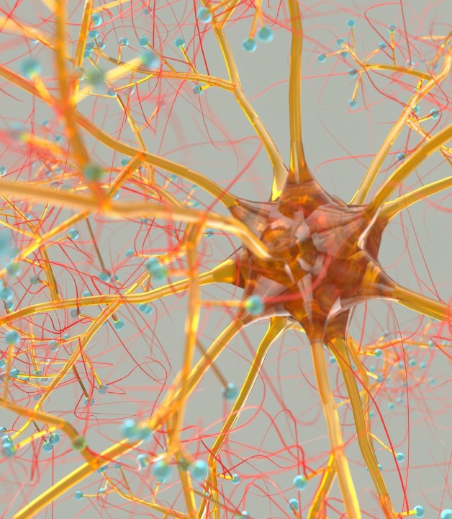
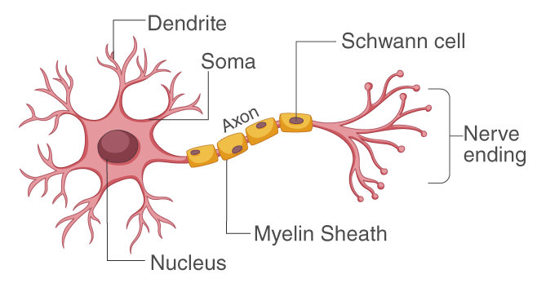
NEURON
The brain is a network of neurons
Dendrites collect electrical stimuli coming from other neurons and accumulate input charges
Activation Process
The neuron fires an electrical impulse
when the total charge exceeds a certain threshold

Slide 3
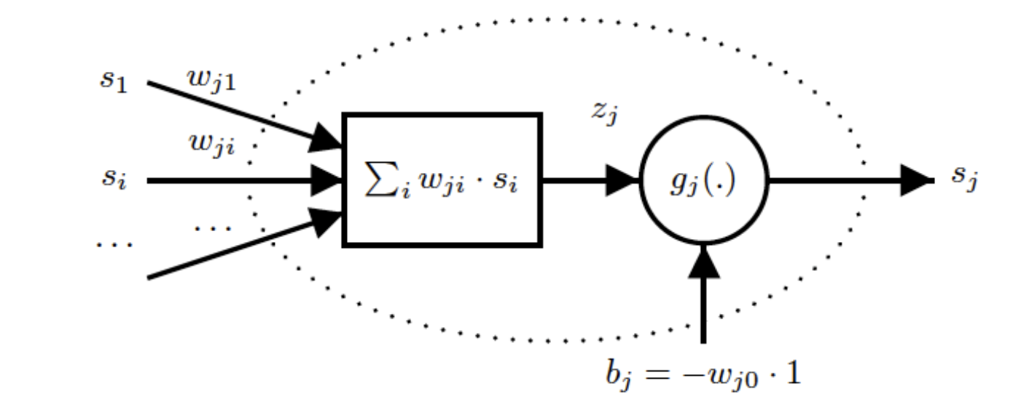
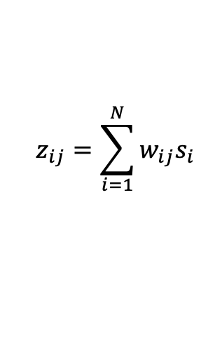
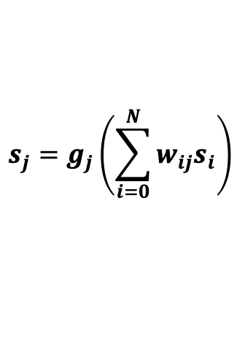
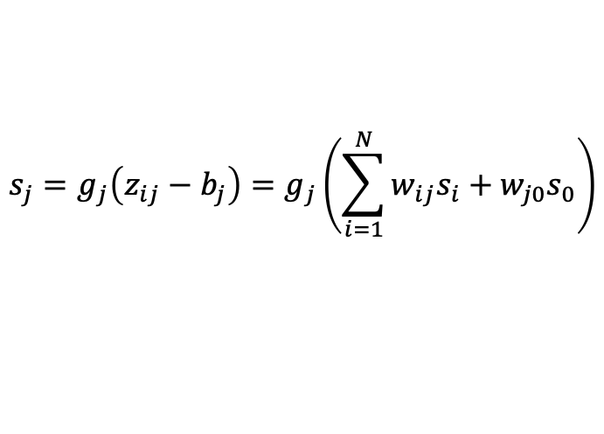


PERCEPTRON
Feed-Forward Model
$$s_{j}=g_{j}\left(z_{ij}−b_{j}\right)=g_{j}\left(\sum_{i=1}^{N}{w_{ij}s_{i}}+w_{j0}s_{0}\right)$$
$$s_{j}=g_{j}\left(\sum_{i=0}^{N}{w_{ij}s_{i}}\right)$$
Output
$$z_{ij}=\sum_{i=1}^{N}{w_{ij}s_{i}}$$
Activation Value
Activation Function
$$g_{j}(∙)$$
Activation Threshold
$$b_{j}=−w_{j0}s_{0}=−w_{j0}$$

Slide 4
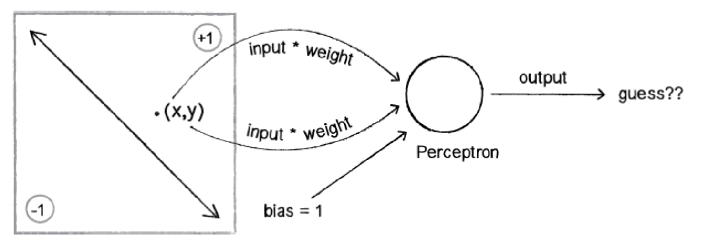


BINARY CLASSIFICATION
Linear separation
Decision boundary is described as a line
$$x_{1}w_{1}+x_{2}w_{2}+w_{0}=0$$
The learning process consists into
learning the weights giving the best linear decision boundary
$$x_{2}=−\frac{w_{1}}{w_{2}}x_{1}−\frac{w_{0}}{w_{2}}$$
The perceptron keeps learning by mistakes
and updates the weights to find the best ones
The output is a class in the classification problem

Slide 5



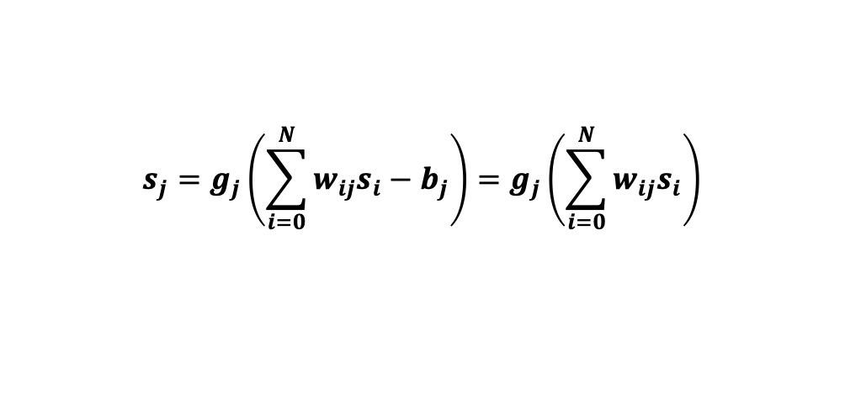



BINARY CLASSIFICATION
Learning Process
Start with a random guess for the weights
$$s_{j}=g_{j}\left(\sum_{i=0}^{N}{w_{ij}s_{i}}−b_{j}\right)=g_{j}\left(\sum_{i=0}^{N}{w_{ij}s_{i}}\right)$$
The perceptron guesses an answer
Compute the error function
$$ε=\hat{s_{j}}−s_{j}$$
where
$$\hat{s_{j}}$$
is the estimated output and
$$s_{j}$$
is the desired output
Adjust the weights
HEBB LEARNING RULE
$w_{i}^{n+1}=w_{i}^{n}$ + $∆w_{i}$
$$∆w_{i}=η ∙ \hat{s_{j}} ∙s_{i}$$
Repeat the process until stop condition
$$η$$
is the learning rate
The number of iterations is denoted as the number of epochs

Slide 6
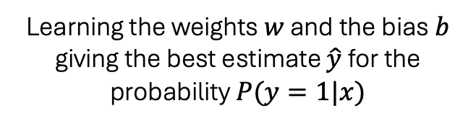


LOGISTIC REGRESSION
for Binary Classification
Logistic Regression is a process of modelling the probability of a discrete outcome
given an input variable.
The most common logistic regression models a binary outcome: TRUE/FALSE, YES/NO, -1/1, 0/1
Learning Process
Given a feature vector x,
logistic regression aims to find
Learning the weights $w$ and the bias $b$ giving the best estimate $\hat{y}$ for the probability $P(y=1|x)$
$$\hat{y}=P(y=1|x)$$
$$\hat{y}=g(w^{T}x+b)$$

Slide 7
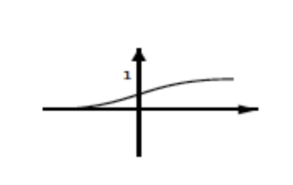
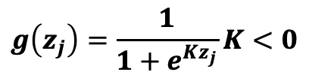
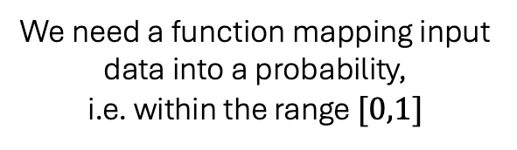


LOGISTIC REGRESSION
for Binary Classification
Sigmoid Function
Activation function $g\left(∙\right)$ is applied
$$g\left(z_{j}\right)=\frac{1}{1+e^{Kz_{j}}}K<0$$
$$\hat{y}=g(w^{T}x+b)$$
We need a function mapping input data into a probability,
i.e. within the range $[0,1]$

Slide 8
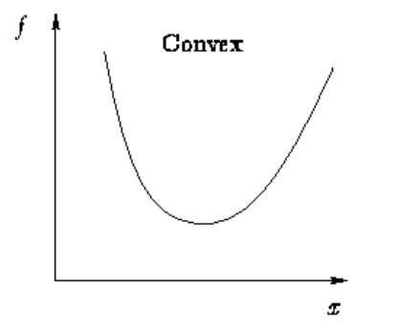
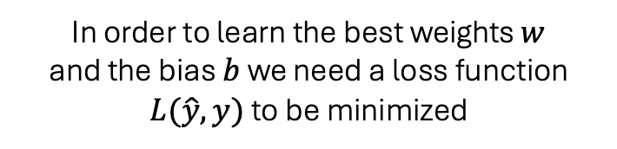
LOGISTIC REGRESSION
for Binary Classification
Loss Function
In order to learn the best weights $w$
and the bias $b$ we need a loss function $L(\hat{y},y)$ to be minimized
$$L\left(\hat{y},y\right)=−log⁡(y log\hat{y}+\left(1−y\right)\log\left(1−\hat{y}\right))$$
for a single feature vector

Slide 9
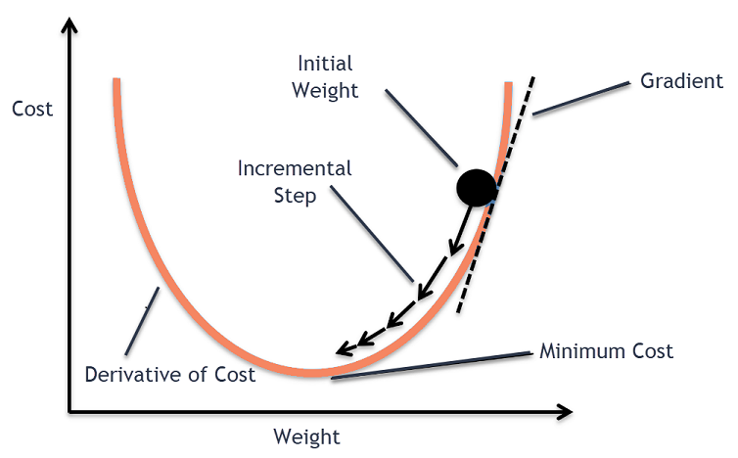
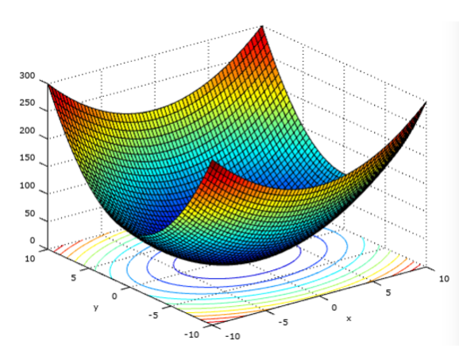
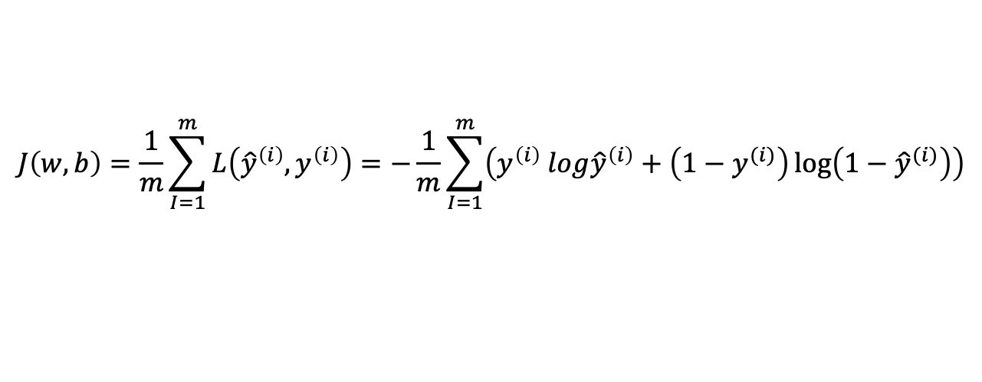
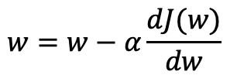

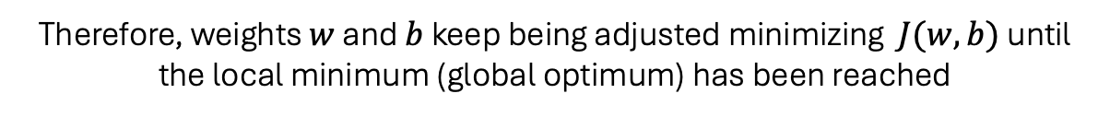
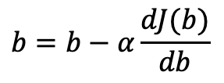
LOGISTIC REGRESSION
for Binary Classification
Cost Function
For the whole dataset (multiple feature vectors)
$$J\left(w,b\right)=\frac{1}{m}\sum_{I=1}^{m}{L\left({\hat{y}}^{\left(i\right)},y^{\left(i\right)}\right)}=−\frac{1}{m}\sum_{I=1}^{m}{\left(y^{\left(i\right)} log{\hat{y}}^{\left(i\right)}+\left(1−y^{(i)}\right)\log\left(1−{\hat{y}}^{(i)}\right)\right)}$$
Therefore, weights $w$ and $b$ keep being adjusted minimizing $J(w,b)$ until the local minimum (global optimum) has been reached
$$w=w−α\frac{dJ(w)}{dw}$$
$$b=b−α\frac{dJ(b)}{db}$$
$α$ is the learning rate
The adjustment procedure is called Back-Propagation and the algorithm
employed for optimization process is called Gradient Descent

Slide 10

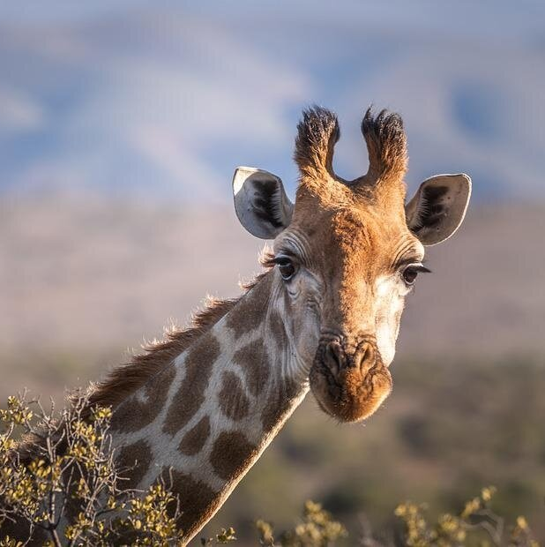
LOGISTIC REGRESSION
for Image Classification

Slide 11
LOGISTIC REGRESSION
px1: B | px2: B | px3: B
px4: B | Px5: B | px6: B
px7: B | px8: B | px9: B
px1: G | px2: G | px3: G
px4: G | Px5: G | px6: G
px7: G | px8: G | px9: G
Flattening Process
Feature Vector
px1: R | px2: R | px3: R
px4: R | Px5: R | px6: R
px7: R | px8: R | px9: R
px1
px2
px3
px4
px5
px6
px7
px8
px9
R
G
B
px1: R
px1: G
px1: B
px2: R
px2: G
px2: B
px3: R
px3: G
px3: B
…
px1 | px2 | px3
px4 | px5 | px6
px7 | px8 | px9
Dimensions: (width, height, channels)
(R, G, B) color

Slide 12

Let’s jump to
the code!

Slide 13
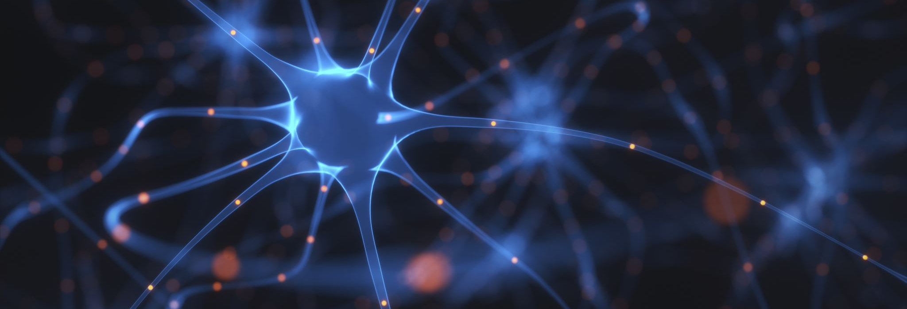
LOGISTIC REGRESSION for Image Classification
THANK YOU!
CREATIVE PROGRAMMING AND COMPUTING
Course
References
Lecture Slides by Prof. Massimiliano Zanoni
Prof. Massimiliano Zanoni
Edgar, T.W. & Manz, D.O.. (2017). Research Methods for Cyber Security. Chapter 4.
Slides and Presentation
by
Student Marco Muraro

